Slide 1
Java Revision
Wrappers

Slide 2
Argument passing
All arguments in Java are passed by value.
The method creates a copy of the argument, and manipulate the copy (not the argument itself).
It is therefore impossible to change the argument from within the method.
This means that it is impossible to change the value of an argument of a primitive type (int, double, char, …).
Reference variables cannot be changed inside methods as well, but their content can be changed.

Slide 3
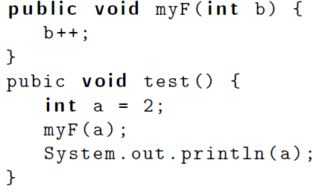
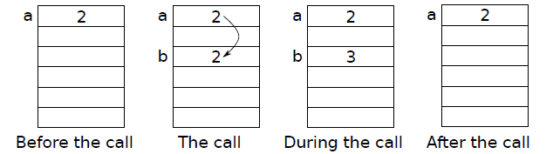






Argument passing: primitive type variables

Slide 4
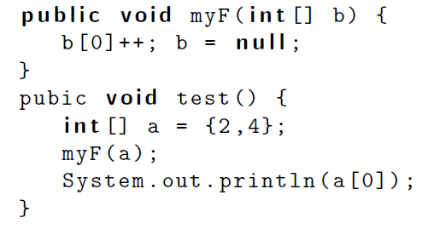
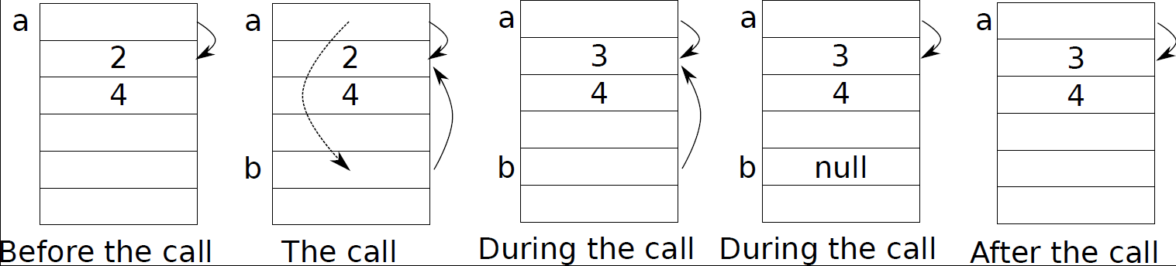
Argument passing: reference variables

Slide 5










Object class
The Object class is the parent class of all the classes in java by default. In other words, it is the topmost class of java.
The Object class is beneficial if you want to refer any object whose type you don't know.

Slide 6
Wrappers
The Java primitive types are NOT classes, and thus cannot be used as easy as objects
If I make an array of Object or any other class, primitive types cannot be stored in it.
Wrapper classes allow to get around this problem
Wrappers are classes that “wrap” objects around primitive values, thus making them compatible with other Java classes
We cannot store an int in an array of Object, but we can store an Integer

Slide 7
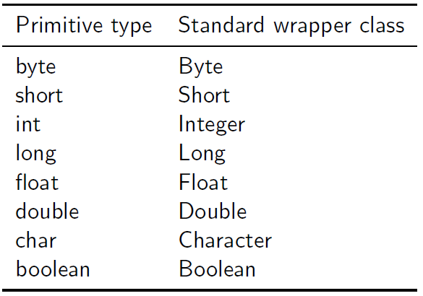




















Java wrappers
Java offers a set of standard wrapper classes for all primitive data types.
Integer i, j, k;
i = new Integer(20); // or i=20; is also correct
j = new Integer(40);
Java wrappers are immutable, which means that their content cannot be changed once created. Hence they cannot be used for parameter passing.

Slide 8






Java wrappers
The wrapper classes also provide extra useful functionality for these types
Ex: Integer.parseInt(String s) is a static method that enables us to convert from a String into an int
Ex: Character.isLetter(char c) is a static method that tests if a letter is a character or not
Integer
int
Double
double

Slide 9
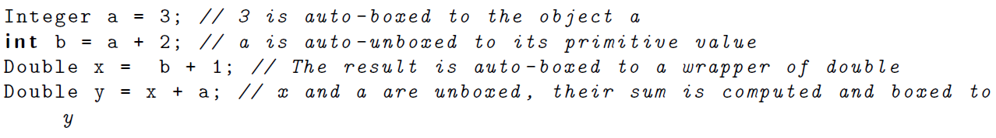














Java wrappers
J2SE 5.0 introduced the feature of auto-boxing and auto-unboxing of standard primitive wrappers. This means that primitive types are automatically converted to their wrappers, and vice-versa, as necessary.

Slide 10
Wrappers
Since all arguments are passed by value in Java, how can we solve problems like the following:
Example: we want to write a method checkModify that takes as input an integer parameter n and performs the following:
If n is odd, the method returns false.
If n is even, the method returns true and changes n to n/2.
Since the return statement returns a boolean, we cannot return the value n/2.
One possible solution is to use wrappers (not Java wrappers).

Slide 11
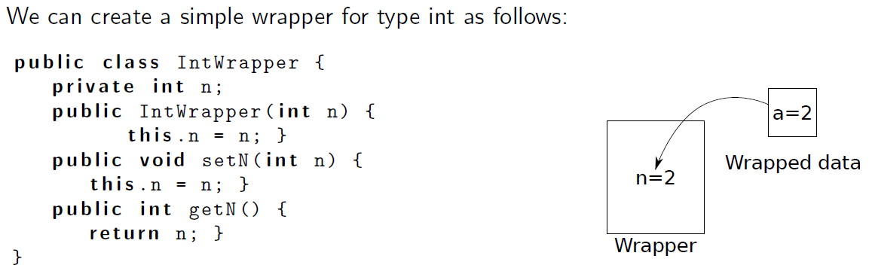
Creation and use of a wrapper
A wrapper is a class that is used to store an object of a certain type and hence allows modifying the object.

Slide 12
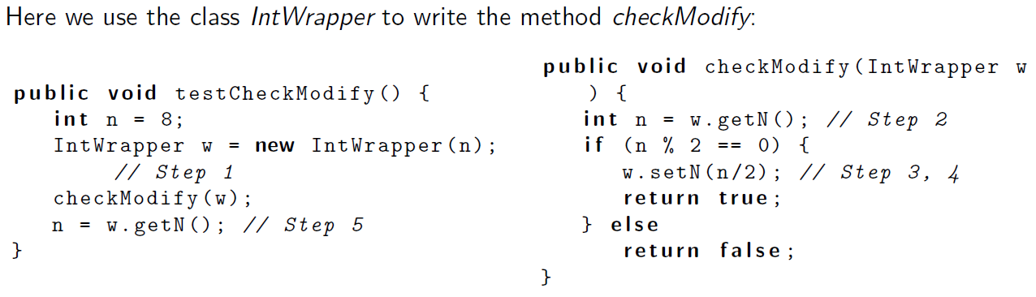

Creation and use of a wrapper
Wrappers are generally used for two purposes:
To store primitive types in classes that require objects.
For passing parameters that can be changed inside a method. This use involves usually 5 steps:
Calling method: create a wrapper object and put the data inside it, then pass it as a parameter.
Called method: take the data from the wrapper. (use getters)
Called method: modify the data.
Called method: update the data of the wrapper. (use setters)
Calling method: take the updated value from the wrapper.

